Slide 1
Understanding What CNNs Learn
Credit: CS143 by James Tompkin

Slide 2
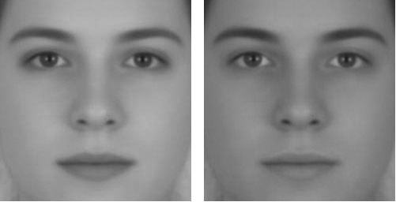
Russell, 2009
Notes:
http://illusionoftheyear.com/2009/05/the-illusion-of-sex/
http://public.gettysburg.edu/~rrussell/Russell_2009.pdf
Left appears female, right appears male.
Eyes and lips have not had their brightness/contrast adjusted, but it looks like the face on the left has darker lips
This is an example of simultaneous contrast adjustment

Slide 3
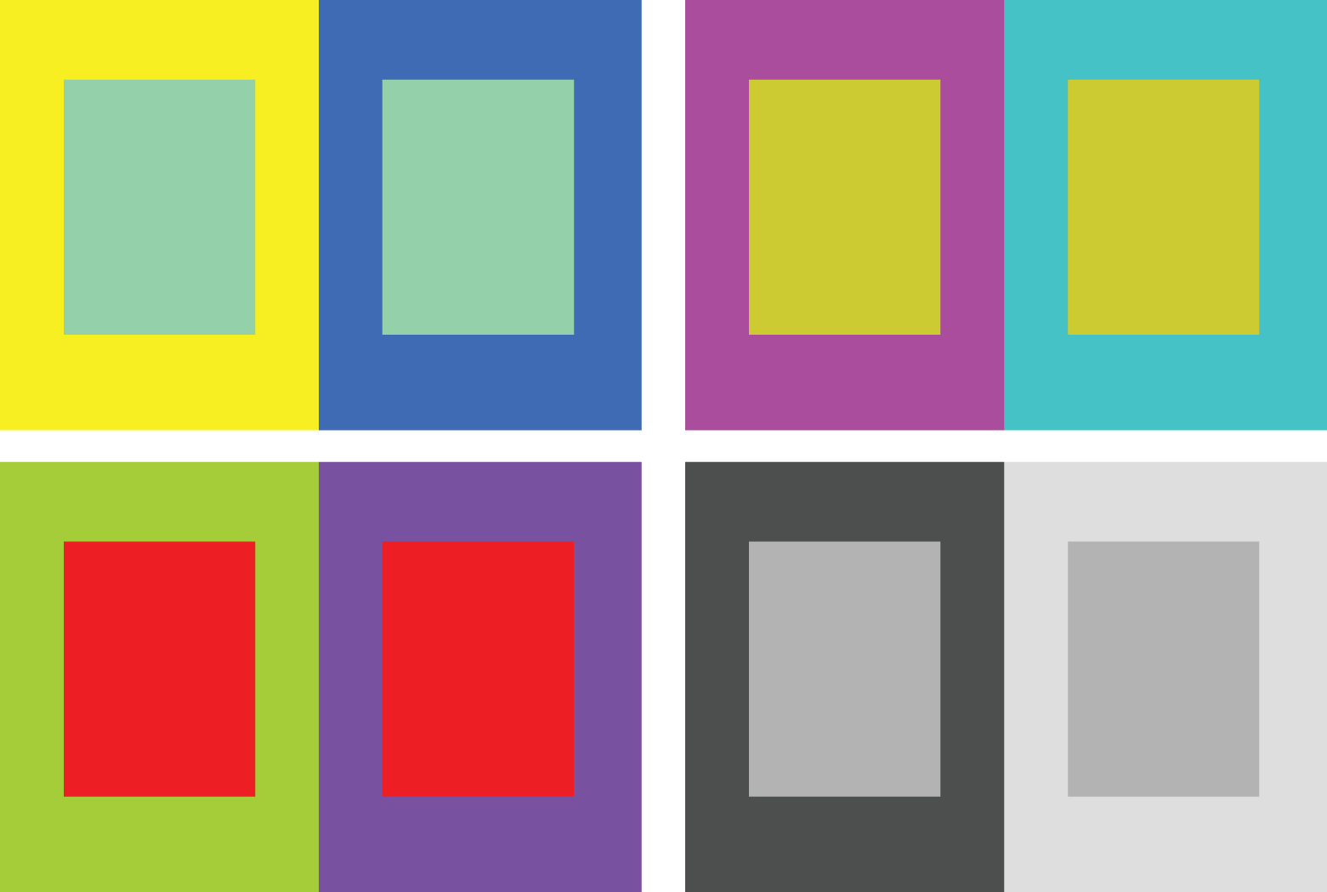
Simultaneous contrast
Notes:
http://pixgood.com/color-contrast-art-examples.html

Slide 4
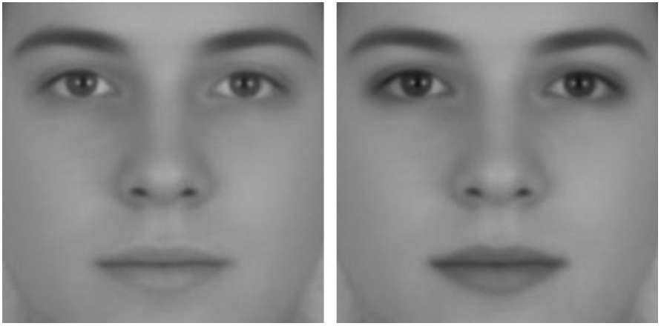
Notes:
In this one, the skin was left unchanged, but the lips and eyes were lightened on the left and darkened on the right.

Slide 5
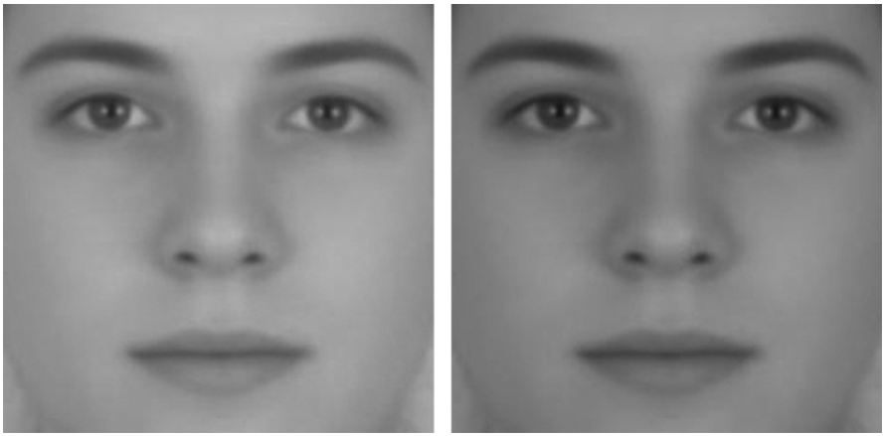
Notes:
No illusion – both faces appear androgenous
“A sex difference in facial contrast and its exaggeration by cosmetics”
Female faces have greater luminance contrast between the eyes, lips, and surrounding skin than do male faces.
This contrast change in some way represents ‘femininity’.
Cosmetics could be seen to increase contrast of these areas, and so increase femininity.

Slide 6
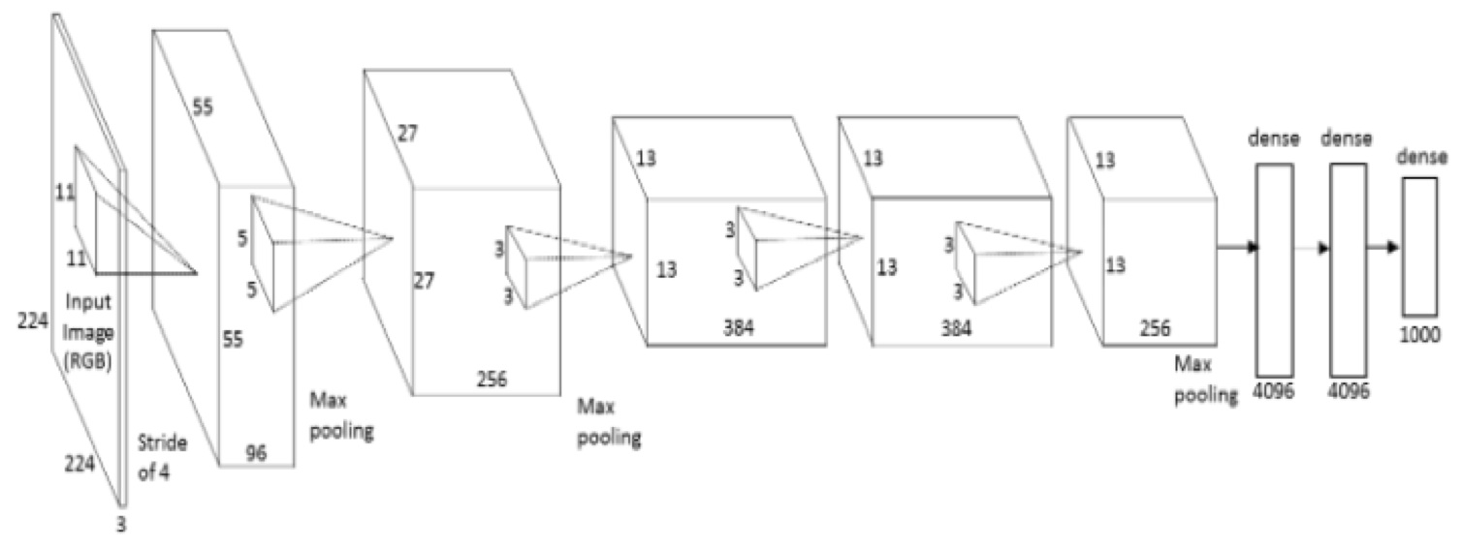
Training Neural Networks
Build network architecture
and define loss function
Pick hyperparameters – learning rate, batch size
Initialize weights + bias in each layer randomly
While loss still decreasing
Shuffle training data
For each data point i=1…n (maybe as mini-batch)
Gradient descent
Check validation set loss
“Epoch“

Slide 7
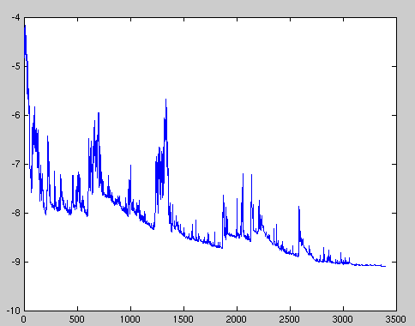
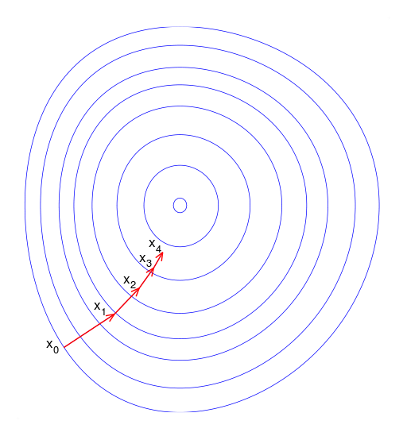
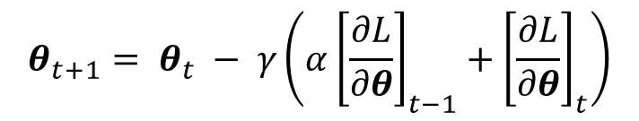
Stochastic Gradient Descent
Try to speed up processing with random training subsets
Loss will not always decrease (locally) as training data point is random, but converges over time.
Momentum
Gradient descent step size is weighted combination over time to dampen ping pong.
$$θ_{t+1}= θ_{t} − γ\left(α{\left[\frac{∂L}{∂θ}\right]}_{t−1}+{\left[\frac{∂L}{∂θ}\right]}_{t}\right)$$
Wikipedia

Slide 8
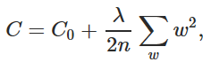
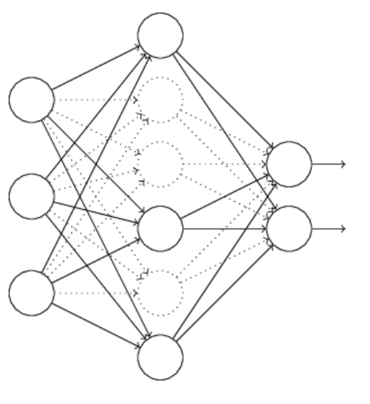
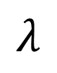
Regularization
Penalize weights for simpler solution
Occam’s razor
Dropout half of neurons for each minibatch
Forces robustness
$$λ$$

Slide 9
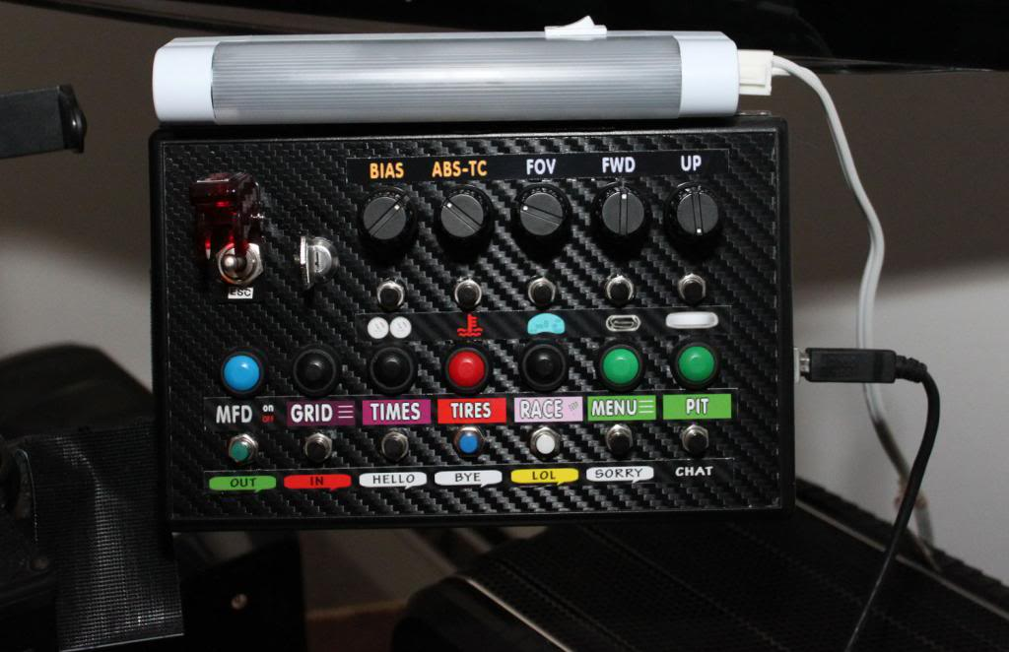
But James…
…I thought we were going to treat machine learning like a black box? I like black boxes.
Deep learning is: - a black box - also a black art.
- Grad student gradient descent : (
http://www.isrtv.com/
Notes:
http://www.isrtv.com/forums/topic/12039-custom-button-box-for-iracing/

Slide 10
When something is not working…
…how do I know what to do next?

Slide 11
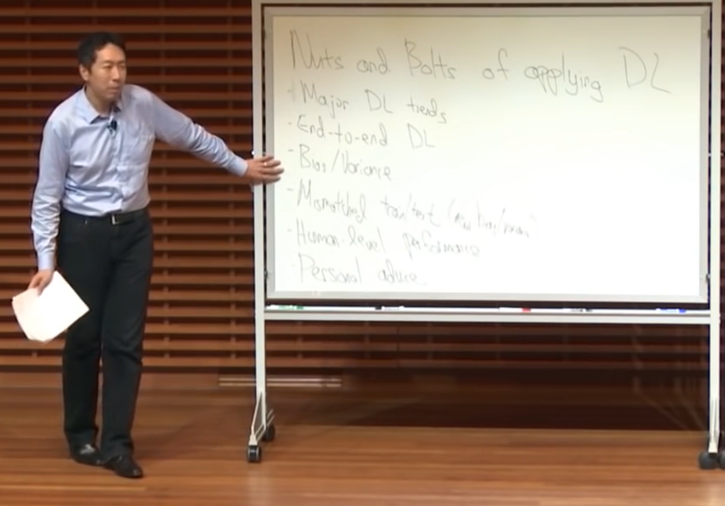
The Nuts and Bolts of Building Applications using Deep Learning
Andrew Ng - NIPS 2016
https://youtu.be/F1ka6a13S9I
Notes:
Andrew Ng leads ~1000 people at Baidu
Was a professor at Stanford

Slide 12
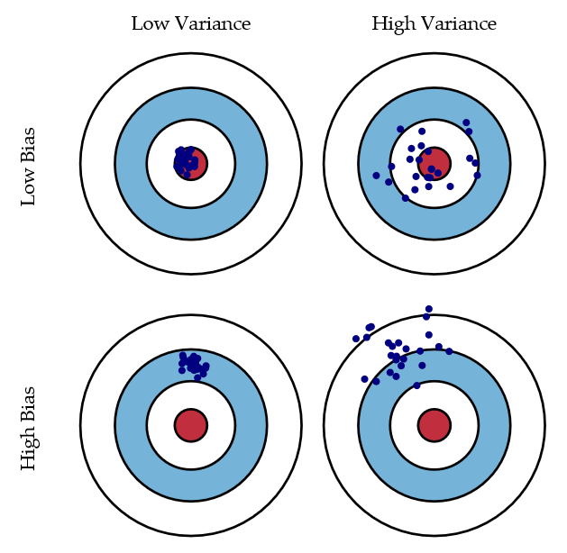
Bias/variance trade-off
"It takes surprisingly long time to grok bias and variance deeply, but
people that understand bias and variance deeply are often able to
drive very rapid progress." --Andrew Ng
Bias = accuracy
Variance = precision
Scott Fortmann-Roe
Notes:
http://scott.fortmann-roe.com/docs/BiasVariance.html
“Bias: The error due to bias is taken as the difference between the expected (or average) prediction of our model and the correct value which we are trying to predict.
Variance: The error due to variance is taken as the variability of a model prediction for a given data point.”

Slide 13
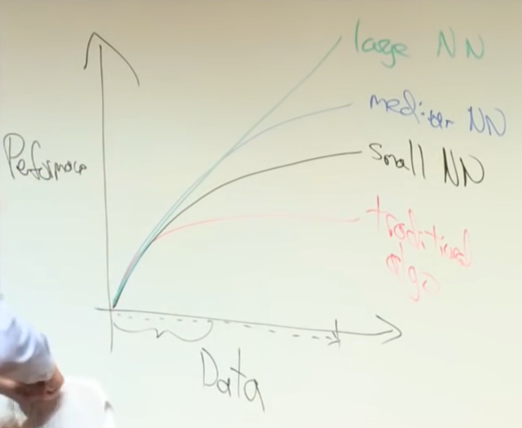

Slide 14
Go collect a dataset
Most important thing:
Training data must represent target application!
Take all your data
60% training
40% testing
20% testing
20% validation (or ‘development’)

Slide 15
Properties
Human level error = 1%
Training set error = 10%
Validation error = 10.2%
Test error = 10.4%
“Bias”
“Variance”
Overfitting to validation
Notes:
In this case, I have high bias – my data isn’t right.
High variance = needs regularization

Slide 16
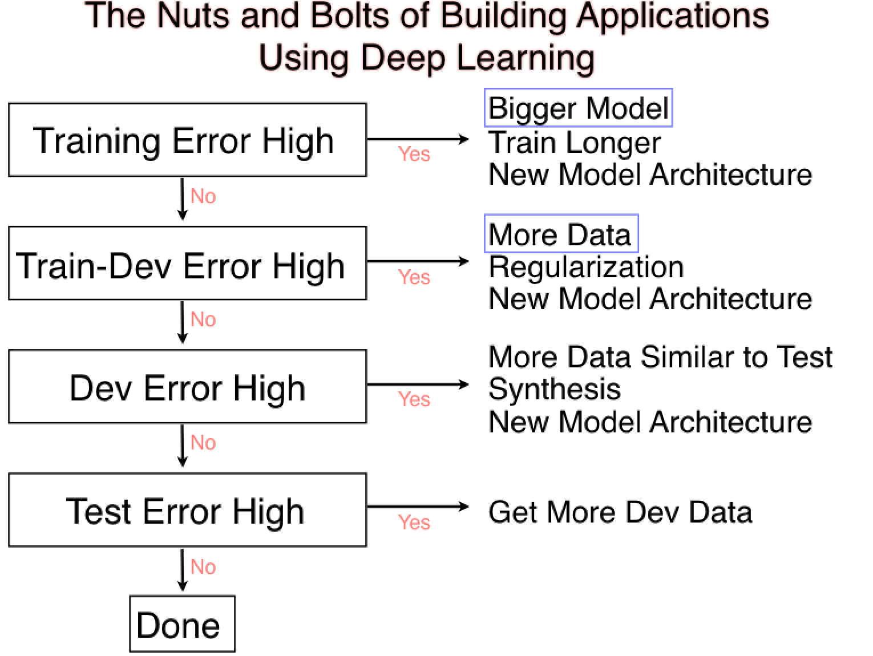
Val
Val
Val
[Andrew Ng]
Notes:
Training error high? High bias problem. Model can’t represent the data.
Bigger model = more parameters
Train longer = make sure my algorithm is correct, e.g., learning rate, so on.
New architecture = complex.
Validation error high? High variance problem

Slide 17
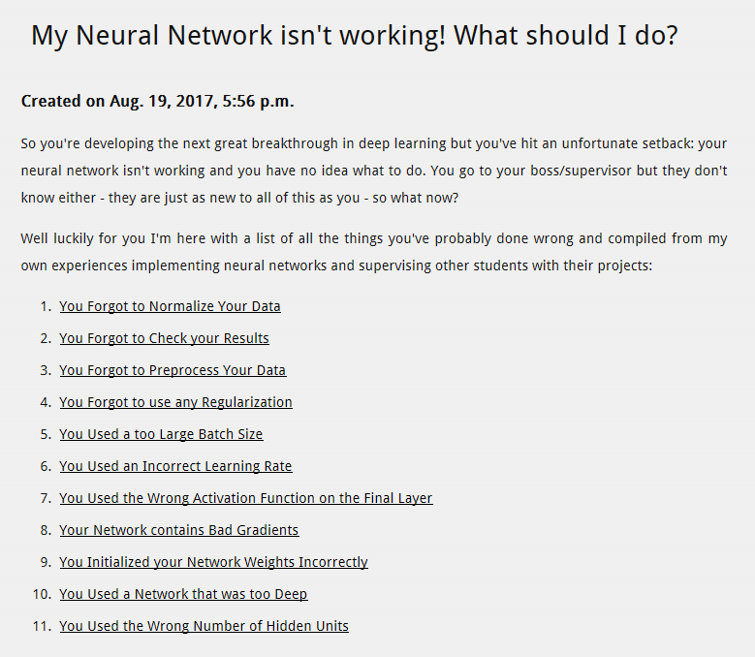
Daniel Holden
http://theorangeduck.com/page/neural-network-not-working

Slide 18
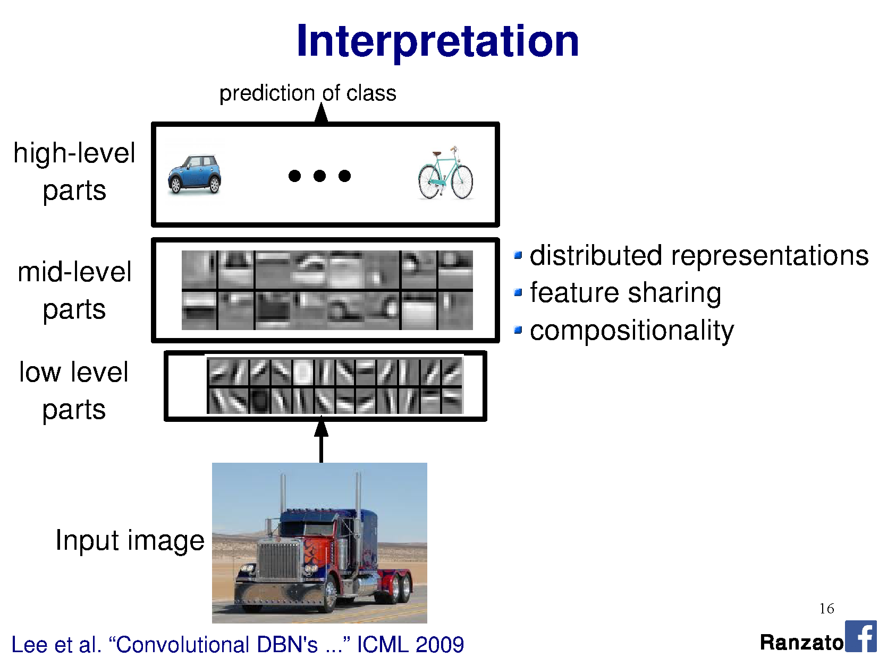

Slide 19
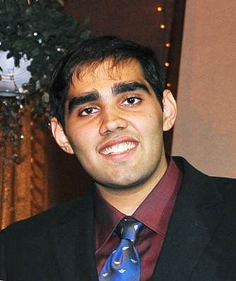
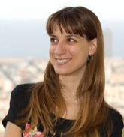
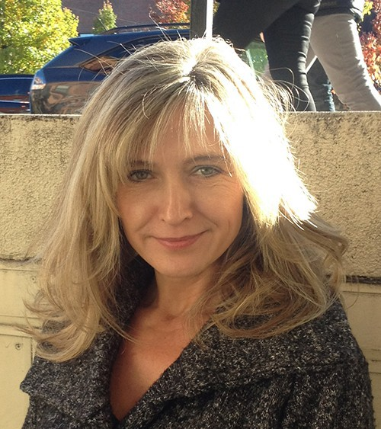

Object Detectors Emerge in Deep Scene CNNs
Bolei Zhou, Aditya Khosla, Agata Lapedriza, Aude Oliva, Antonio Torralba
Massachusetts Institute of Technology
ICLR 2015
Notes:
ICLR = international conference on learning representations

Slide 20
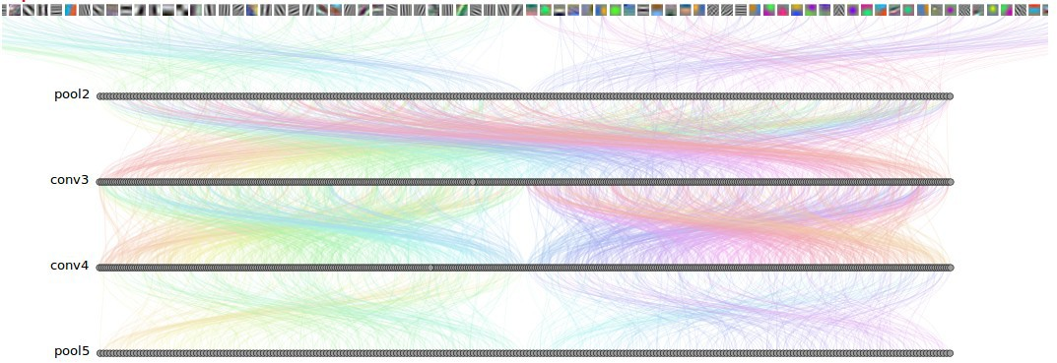
How Objects are Represented in CNN?
CNN uses distributed code to represent objects.
Conv1
Conv2
Conv3
Conv4 Pool5
Agrawal, et al. Analyzing the performance of multilayer neural networks for object recognition. ECCV, 2014 Szegedy, et al. Intriguing properties of neural networks.arXiv preprint arXiv:1312.6199, 2013.
Zeiler, M. et al. Visualizing and Understanding Convolutional Networks, ECCV 2014.

Slide 21
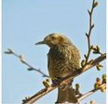
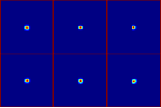
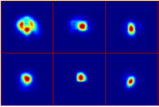
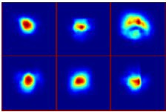
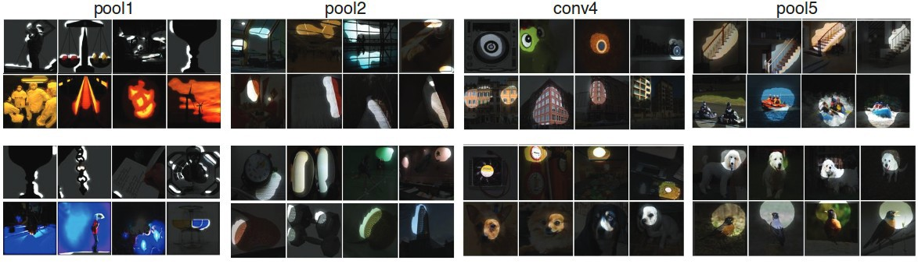
Estimating the Receptive Fields
Estimated receptive fields
pool1
Actual size of RF is much smaller than the theoretic size
conv3 pool5
Segmentation using the RF of Units
More semantically meaningful

Slide 22
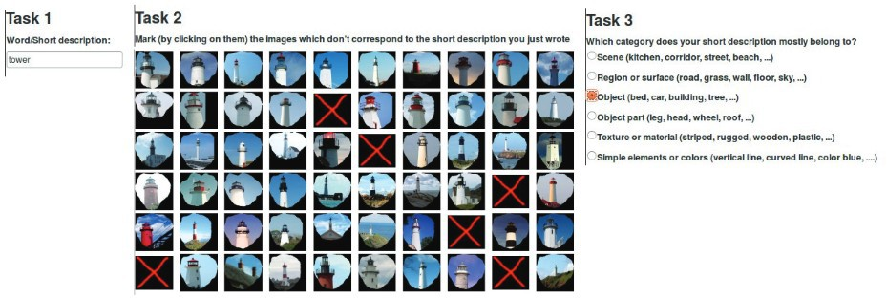
Annotating the Semantics of Units
Top ranked segmented images are cropped and sent to Amazon Turk for annotation.

Slide 23
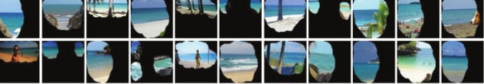
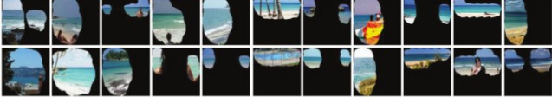

Annotating the Semantics of Units
Pool5, unit 76; Label: ocean; Type: scene; Precision: 93%

Slide 24
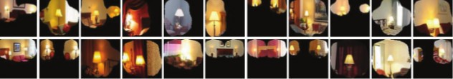
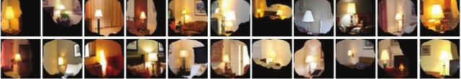
Annotating the Semantics of Units
Pool5, unit 13; Label: Lamps; Type: object; Precision: 84%

Slide 25
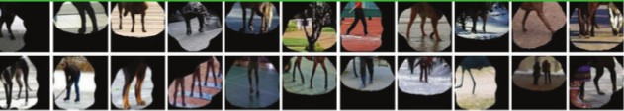
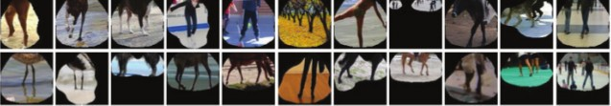

Annotating the Semantics of Units
Pool5, unit 77; Label:legs; Type: object part; Precision: 96%

Slide 26
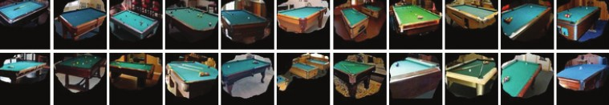
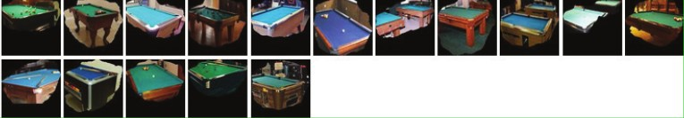
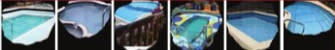
Annotating the Semantics of Units
Pool5, unit 112; Label: pool table; Type: object; Precision: 70%

Slide 27
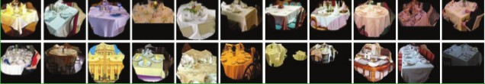
Annotating the Semantics of Units
Pool5, unit 22; Label: dinner table; Type: scene; Precision: 60%

Slide 28
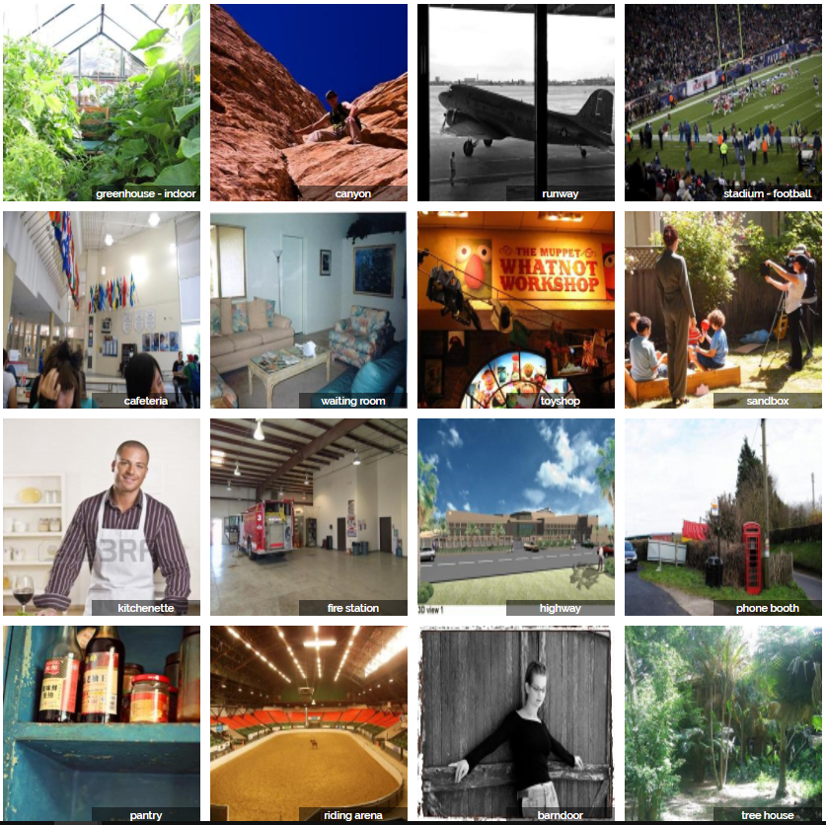
ImageNet vs. PlacesNet
http://places2.csail.mit.edu/demo.html
ImageNet
~1 mil object-level images over 1000 classes
PlacesNet
~1.8 million images from 365 scene categories (at most 5000 images per category).
Notes:
Vs SUN 397, which had at least 100 images in each of 397 classes

Slide 29

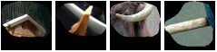

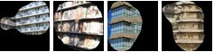
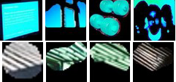
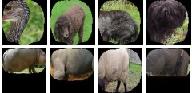
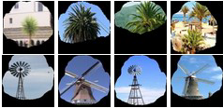
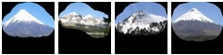
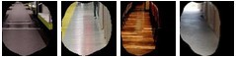
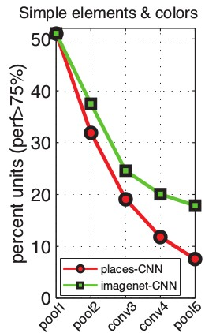
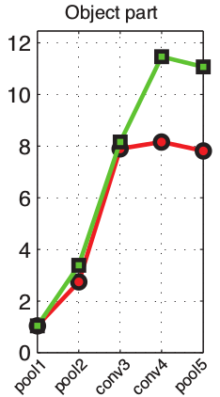
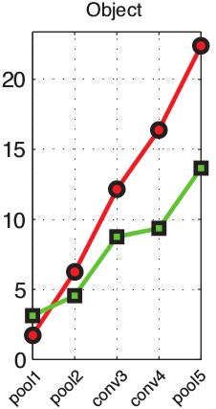
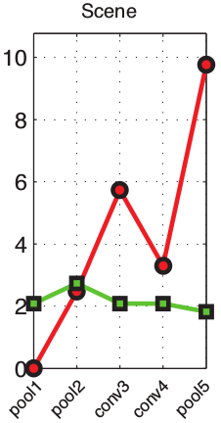
Distribution of Semantic Types at Each Layer

Slide 30
Distribution of Semantic Types at Each Layer
Object detectors emerge within CNN trained to classify scenes, without any object supervision!

Slide 31
Interesting CNN properties …or other ways to measure reception
http://yosinski.com/deepvis

Slide 32


Occlusion experiments
(as a function of the position of the square of zeros in the original image)
[Zeiler & Fergus 2014]
Andrej Karpathy

Slide 33
Occlusion experiments
(as a function of the position of the square of zeros in the original image)
[Zeiler & Fergus 2014]
Andrej Karpathy

Slide 34


What input to a neuron maximizes a class score?
To visualize the function of a specific unit in a neural network, we synthesize an input to that unit which causes high activation.
Neuron of choice i
An image of random noise x.
Repeat:
Forward propagate: compute activation a_{i}(x)
Back propagate: compute gradient at neuron ∂a_{i}(x) / ∂x
Add small amount of gradient back to noisy image.
Andrej Karpathy
Notes:
Activation = result of the convolution
Next, we do a forward pass using this image xx as input to the network to compute the activation ai(x)ai(x) caused by xx at some neuron ii somewhere in the middle of the network. Then we do a backward pass (performing backprop) to compute the gradient of ai(x)ai(x) with respect to earlier activations in the network. At the end of the backward pass we are left with the gradient ∂ai(x)/∂x∂ai(x)/∂x , or how to change the color of each pixel to increase the activation of neuron ii . We do exactly that by adding a little fraction αα of that gradient to the image:
x←x+α⋅∂ai(x)/∂x
We keep doing that repeatedly until we have an image x∗x∗ that causes high activation of the neuron in question.

Slide 35

What image maximizes a class score?
[Understanding Neural Networks Through Deep Visualization, Yosinski et al. , 2015]
http://yosinski.com/deepvis
Andrej Karpathy

Slide 36

What image maximizes a class score?
Andrej Karpathy

Slide 37
Wow!
They just ‘fall out’!
Notes:
https://blog.keras.io/the-limitations-of-deep-learning.html

Slide 38

Francois Chollet - https://blog.keras.io/the-limitations-of-deep-learning.html
Notes:
But no

Slide 39

Breaking CNNs
Intriguing properties of neural networks [Szegedy ICLR 2014]
Andrej Karpathy

Slide 40

Fooling a linear classifier
To fool a linear classifier, add a small multiple of the weight vector to the training example:
x ← x + αw
http://karpathy.github.io/2015/03/30/breaking-convnets/
Jia-bin Huang

Slide 41

Breaking CNNs
Deep Neural Networks are Easily Fooled: High Confidence Predictions for Unrecognizable Images [Nguyen et al. CVPR 2015]
Jia-bin Huang
Notes:
But what types of images does this process produce? As we showed in a previous paper titled Deep networks are easily fooled: high confidence predictions for unrecognizable images, the results when this process is carried out on final-layer output neurons are images that the DNN thinks with near certainty are everyday objects, but that are completely unrecognizable as such.
Synthesizing images without regularization leads to “fooling images”: The DNN is near-certain all of these images are examples of the listed classes (over 99.6% certainty for the class listed under the image), but they are clearly not
http://www.cv-foundation.org/openaccess/content_cvpr_2015/papers/Nguyen_Deep_Neural_Networks_2015_CVPR_paper.pdf

Slide 42

Francois Chollet - https://blog.keras.io/the-limitations-of-deep-learning.html
Notes:
Do not anthropormorphise what is going on! Is not a general intelligence that can abstract.

Slide 43

Francois Chollet - https://blog.keras.io/the-limitations-of-deep-learning.html

Slide 44
Reconstructing images
Question: Given a CNN code, is it possible to reconstruct the original image?
Andrej Karpathy

Slide 45


Reconstructing images
Find an image such that:
Its code is similar to a given code
It “looks natural”
Neighboring pixels should look similar
Image
Andrej Karpathy

Slide 46

Reconstructing images
original image
Reconstructions from the 1000 log probabilities for ImageNet (ILSVRC)
classes
Understanding Deep Image Representations by Inverting Them
[Mahendran and Vedaldi, 2014]
Andrej Karpathy

Slide 47

Reconstructing images
Reconstructions from the representation after last last pooling layer
(immediately before the first Fully Connected layer)
Andrej Karpathy

Slide 48




DeepDream
DeepDream https://github.com/google/deepdream
Andrej Karpathy

Slide 49



DeepDream
DeepDream modifies the image in a way that “boosts” all activations, at any layer
This creates a feedback loop: e.g., any slightly detected dog face will be made more and more dog-like over time.
Andrej Karpathy

Slide 50
DeepDream
Deep Dream Grocery Trip
https://www.youtube.com/watch?v=DgPaCWJL7XI
Deep Dreaming Fear & Loathing in Las Vegas: the Great San Francisco Acid Wave https://www.youtube.com/watch?v=oyxSerkkP4o
Andrej Karpathy

Slide 51
Style transfer

Slide 52



Neural Style
[ A Neural Algorithm of Artistic Style by Leon A. Gatys, Alexander S. Ecker, and Matthias Bethge, 2015] good implementation by Justin Johnson in Torch: https://github.com/jcjohnson/neural-style
Andrej Karpathy

Slide 53

Neural Style
Step 1: Extract content targets (ConvNet activations of all layers for the given content image)
content activations
e.g.
at CONV5_1 layer we would have a [14x14x512] array of target activations
Andrej Karpathy

Slide 54
Neural Style
Step 2: Extract style targets (Gram matrices of ConvNet activations of all layers for the given style image)
style gram matrices
e.g.
at CONV1 layer (with [224x224x64] activations) would give a [64x64] Gram matrix of all pairwise activation covariances (summed across spatial locations)
Andrej Karpathy

Slide 55

Neural Style
Step 3: Optimize over image to have:
The content of the content image (activations match content)
The style of the style image (Gram matrices of activations match style)
match content
match style
Adapted from Andrej Karpathy

Slide 56








Neural Style
make your own easily on deepart.io
Andrej Karpathy

